Slide 1

Computer Networks
Simple Network Management Protocol
(SNMP)
S.V.Jansi Rani
Associate Professor / CSE

Slide 2
AGENDA
Network Management
SNMP
Concept Management Components Structure of Management Information (SMI)
Management Information Base (MIB)
SNMP

Slide 3



Slide 4
NETWORK MANAGEMENT SYSTEM
Functions performed by a network management system can be divided into five broad categories
Configuration Management Fault Management Performance Management
Security Management
Accounting Management

Slide 5
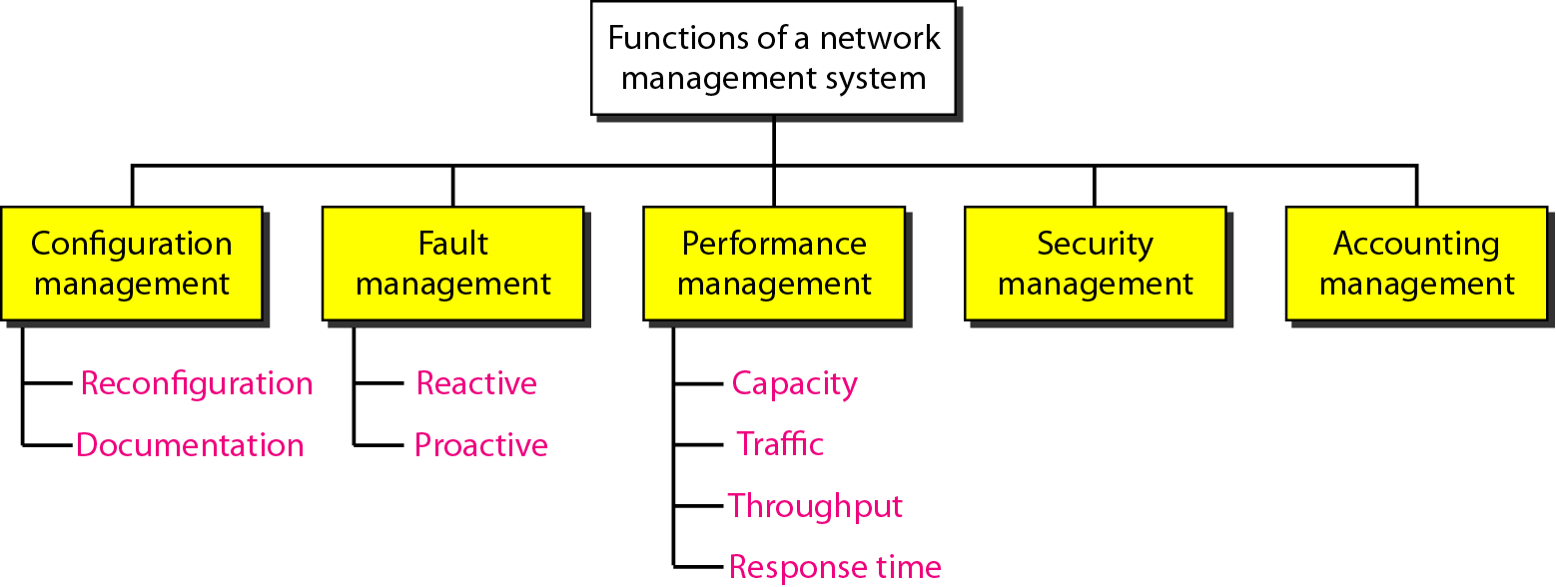
Functions of a network management system
Reconf -hw, sw, acc conf
Reactive - detecting, isolating, correcting, recording faults

Slide 6
SIMPLE NETWORK MANAGEMENT
PROTOCOL (SNMP)
The Simple Network Management Protocol (SNMP) is a framework for managing devices in an internet using the TCP/IP protocol suite. It provides a set of fundamental operations for monitoring and maintaining an internet.
Topics discussed in this section:
Concept Management Components Structure of Management Information (SMI)
Management Information Base (MIB)
SNMP

Slide 7
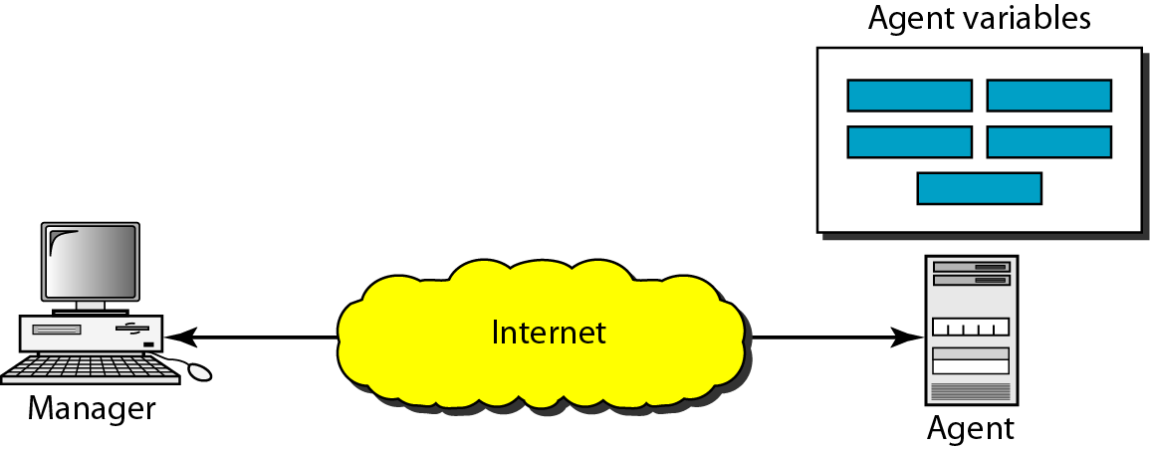
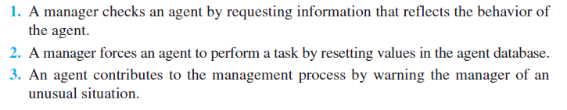
SNMP concept

Slide 8
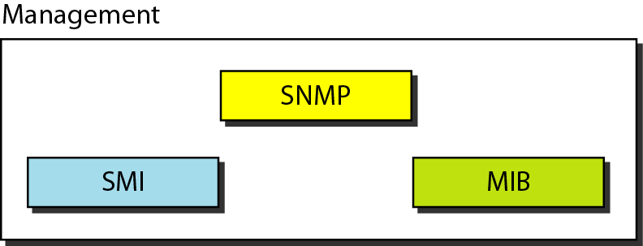
Components of network management on the Internet

Slide 9

Note
SNMP defines the format of packets exchanged between a manager and
an agent. It reads and changes the status (values) of objects (variables)
in SNMP packets.

Slide 10
Note
SMI defines the general rules for naming objects, defining object types (including
range and length), and showing how to encode objects and values. SMI does not define the number of objects an entity should manage or name the objects to be managed or define the association between the objects and their values.

Slide 11
Note
MIB creates a collection of named objects, their types, and their relationships to each other
in an entity to be managed.

Slide 12
Note
We can compare the task of network management to the task of writing a program.
❏ Both tasks need rules/ lang.syntax - SMI.
❏ Both tasks need variable declarations - MIB.
❏ Logic/ action - SNMP.

Slide 13
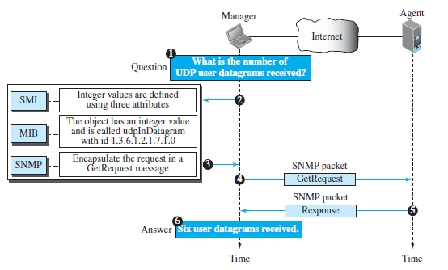
Management overview

Slide 14
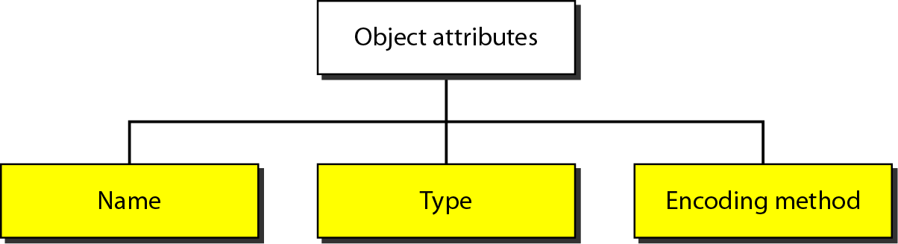
SMI - Object attributes

Slide 15
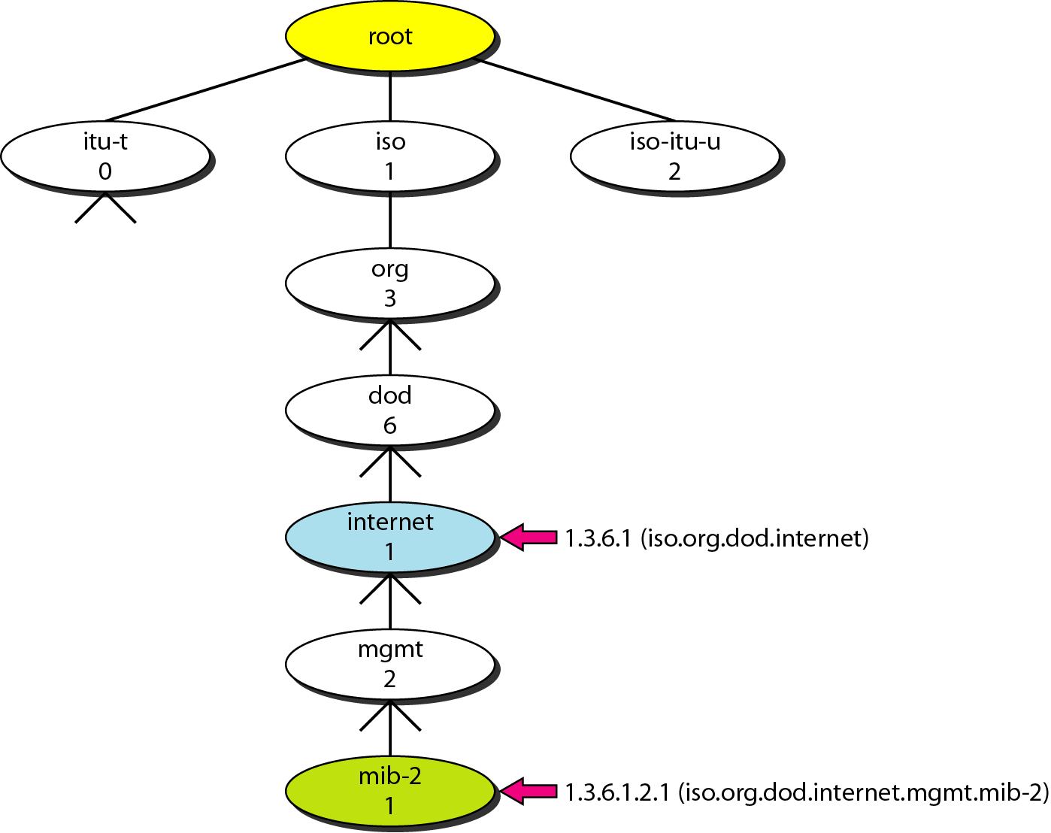
Object identifier

Slide 16
Note
All objects managed by SNMP are given an object identifier.
The object identifier always starts with 1.3.6.1.2.1.

Slide 17
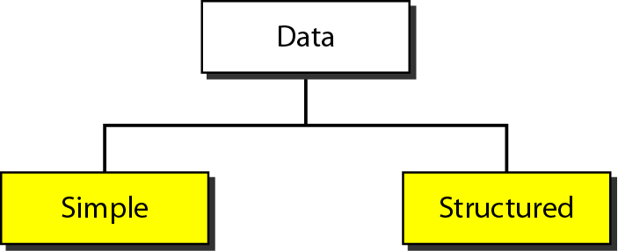
Data type

Slide 18
Data types
Structured –Sequence, Sequence of

Slide 19
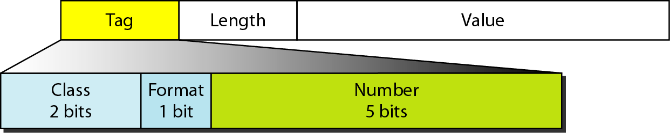
Encoding format

Slide 20
Codes for data types

Slide 21
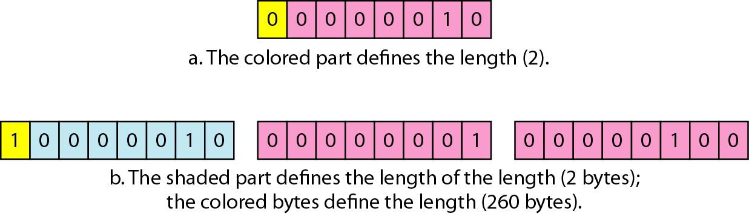
Length format

Slide 22
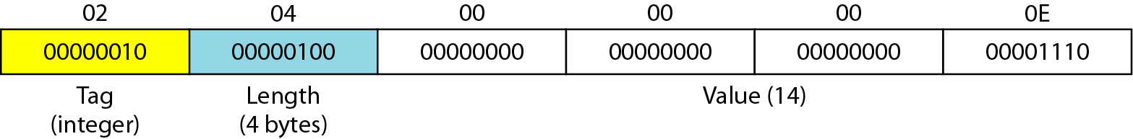
Example 28.1
Figure 28.11 shows how to define INTEGER 14.
Figure 28.11 Example 28.1, INTEGER 14

Slide 23
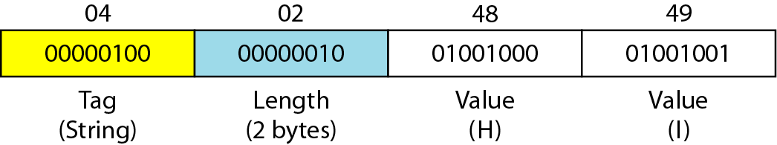
Example 28.2
Figure 28.12 shows how to define the OCTET STRING “HI”.
Figure 28.12 Example 28.2, OCTET STRING “HI”

Slide 24
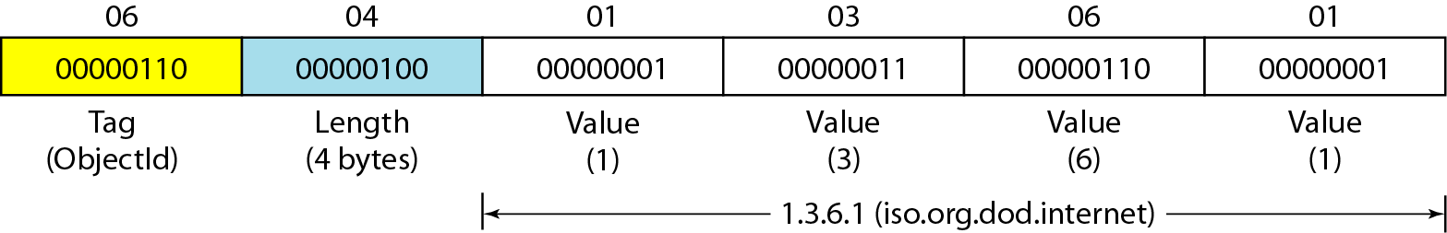
Example 28.3
Figure 28.13 shows how to define ObjectIdentifier 1.3.6.1 (iso.org.dod.internet).
Figure 28.13 Example 28.3, ObjectIdentifier 1.3.6.1

Slide 25
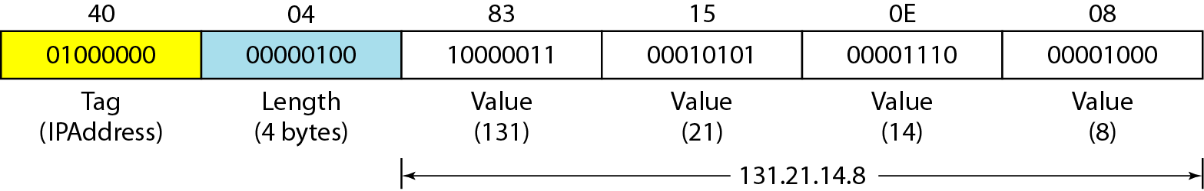
Example 28.4
Figure 28.14 shows how to define IPAddress 131.21.14.8..
Figure 28.14 Example 28.4, IPAddress 131.21.14.8.

Slide 26
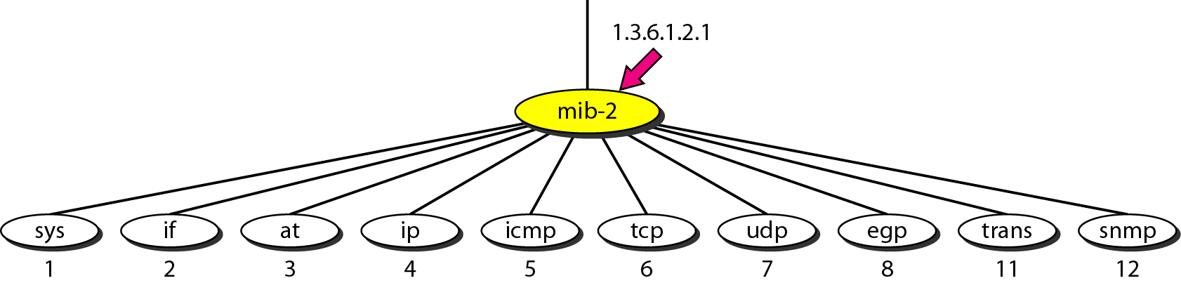
mib-2

Slide 27
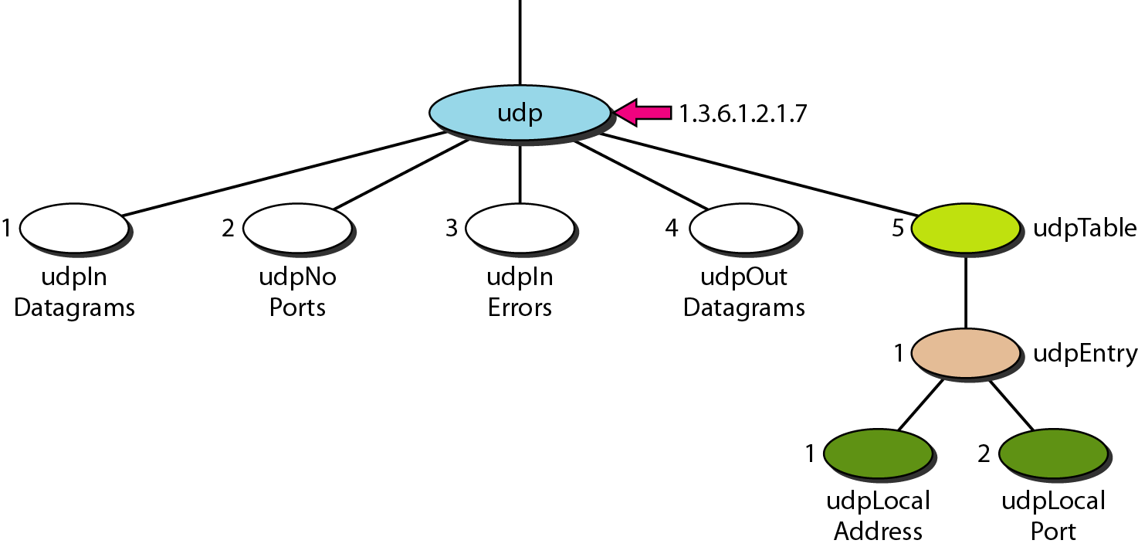
udp group

Slide 28
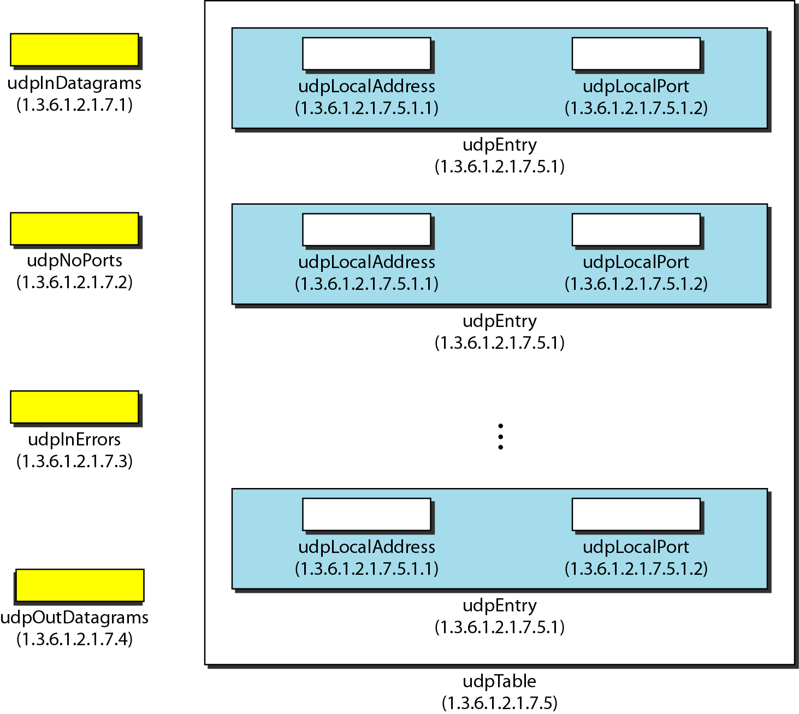
udp variables and tables

Slide 29
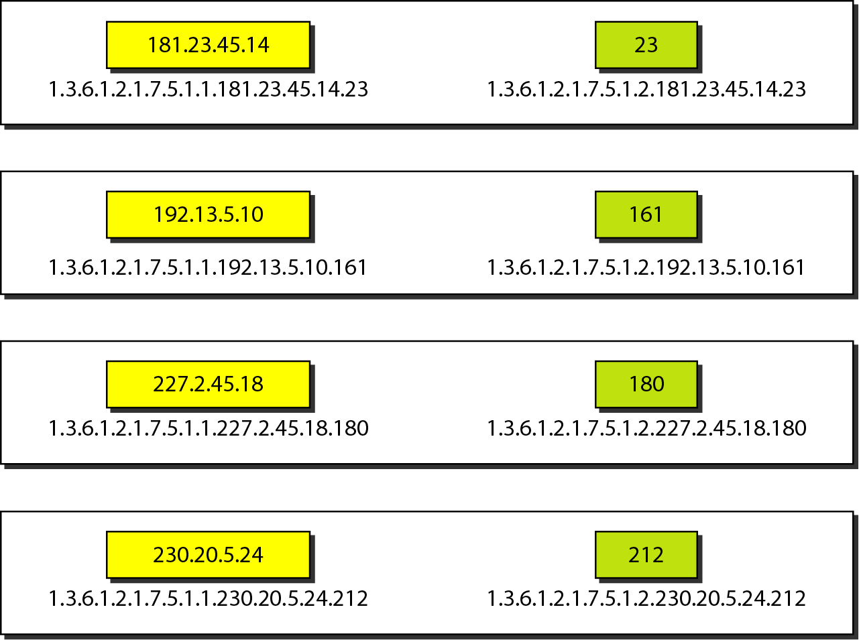
Indexes for udpTable

Slide 30
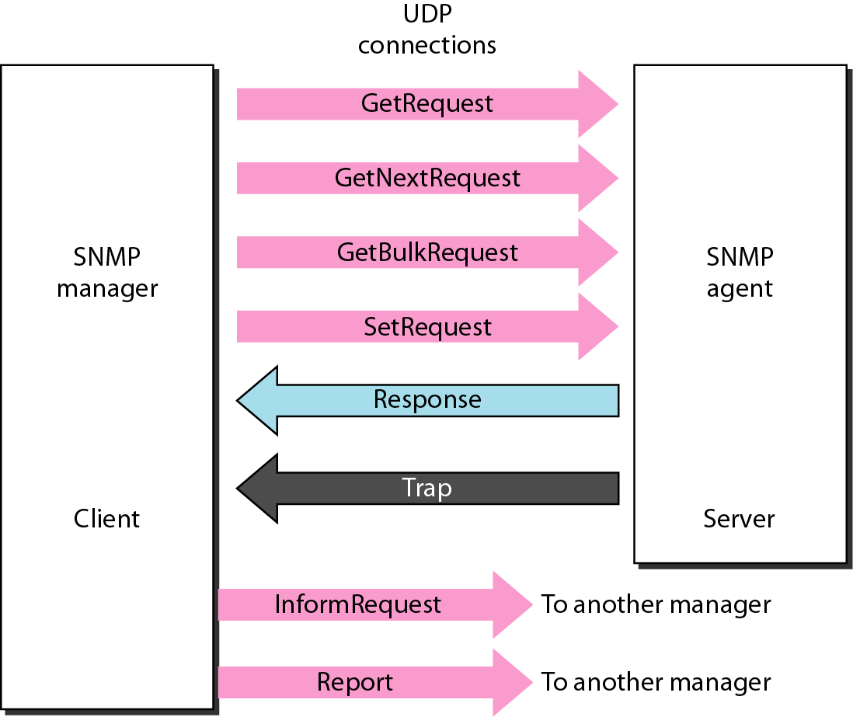
SNMP PDUs

Slide 31
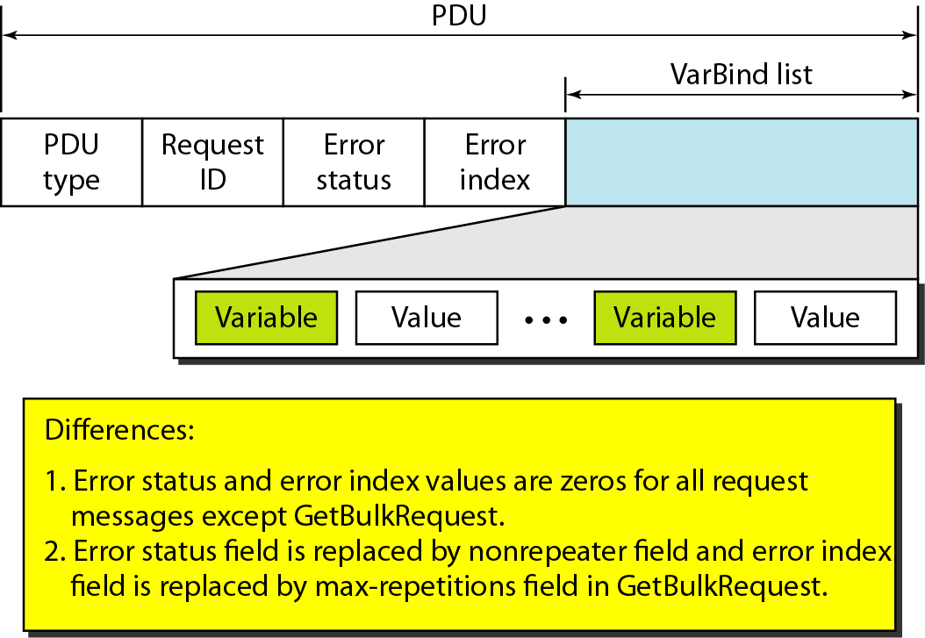
SNMP PDU format

Slide 32
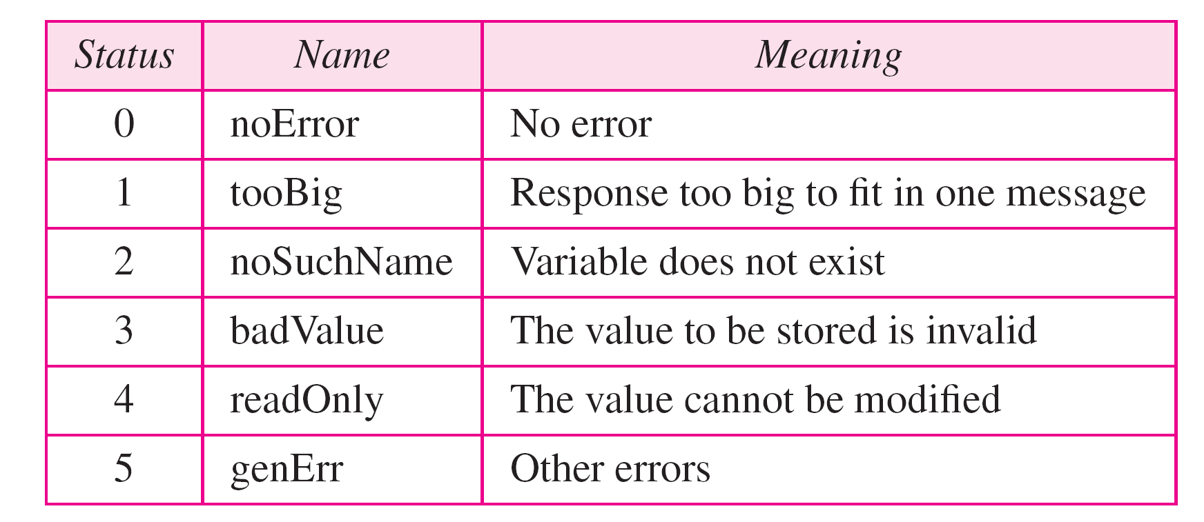
Types of errors

Slide 33
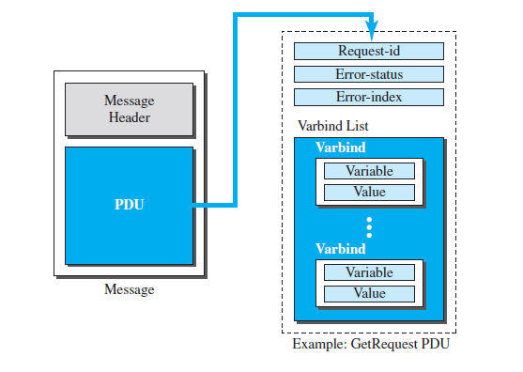
SNMP message

Slide 34
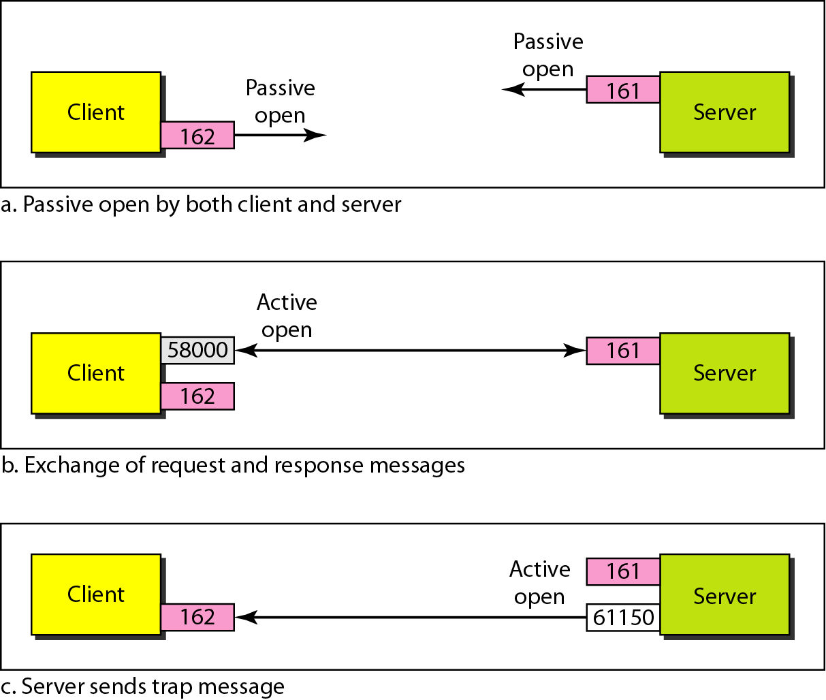
Port numbers for SNMP

Slide 35
Check Your Understanding
What are the different objects that are used by SNMP?
How structured data are formed?
List the functionalities of network management

Slide 36
Outcome
Student should understood and will be able to explain
Network Management
SNMP
Concept Management Components Structure of Management Information (SMI)
Management Information Base (MIB)
SNMP

Slide 37
THANK YOU

